Slide 1
Bellabeat Case Study
A market analytical study of using smart health trackers
M.Salah/31-10-21

Slide 2

Agenda
1
2
3
4
Project overview
Data sources
Findings
Recommendations

Slide 3
Project overview
Smart devices are an elementary part of our daily life, our objective is to study the user behavior and the data driven decisions to be taken by manufacturers to achieve growth.

Slide 4
Data Sources
We’re using the Fitbit dataset from Kaggle.
The dataset is under CC0: public domain license.
The dataset contains health tracking data of 30 users.
The dataset contains total 18 files in CSV format.

Slide 5
Data limitations
Reliability: LOW, dataset was collected from only 30 users which is not enough, also gender is not known.
Originality: LOW, dataset was collected by a third party organization.
Comprehensive: HIGH, dataset contains the needed healthy features to be studied.
Current: MEDIUM, dataset was collected 5 years ago which is not so far from now.
Cited: HIGH, dataset collectors and sources were documented properly.

Slide 6
Data Selection
Our focus will be on the daily level of the collected data to provide high level insight of the usage patterns of users
Selected tables are:
dailyActivity_merged.csv
dailyCalories_merged.csv
dailyIintensities_merged.csv
daily_Steps_merged.csv
sleepDay_merged.csv
weightLoginfo_merged.csv

Slide 7
Data Analysis
first we changed the format of the date time columns in the sheets to “short date” format.
Then we checked the data consistency by counting the unique IDs of users and we found the following:
Daily Activity table has only data from 7 users.
Sleep Day table has only data from 24 users.
Weight Log Info table has only data from 8 users.
In order to categorize the users body type we will wrangle the BMI column in the weight log info table to divide users into 4 categories (Underweight, Normal, Overweight, Very Overweight) based on their BMI score.

Slide 8
Findings
Hypothesis were made with the available data on Daily Activity, Sleep Day and Weight Log Info tables.
We will use the intensities table instead of the activity table due to the data shortage in the activity table.
The weight log info table consists only of 8 users data

Slide 9
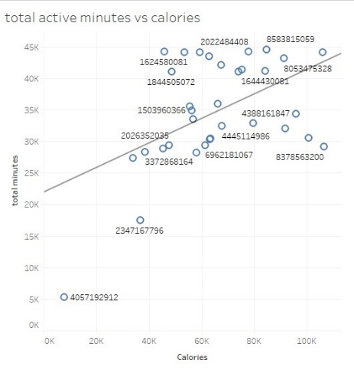
Findings
As shown in the figure there’s a positive relationship between the activity total minutes and the burnt calories of users.

Slide 10
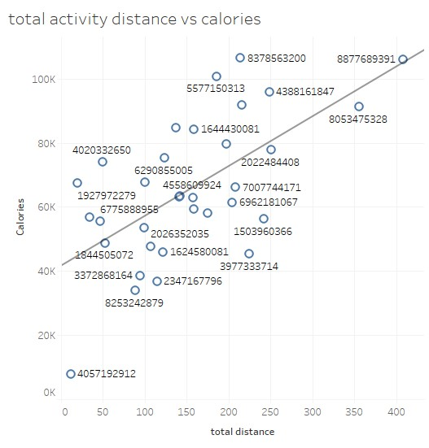
Findings
As shown in the figure there’s a positive relationship between the activity total distance and the burnt calories of users.

Slide 11
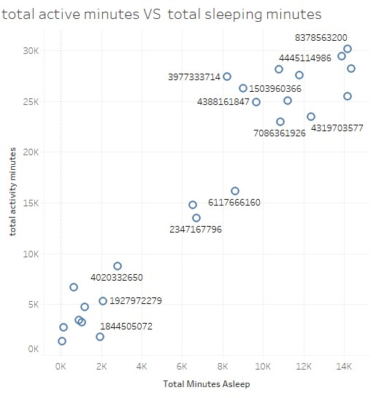
Findings
As shown in the figure there’s a positive relationship between the activity total time and the total sleeping time of users.

Slide 12
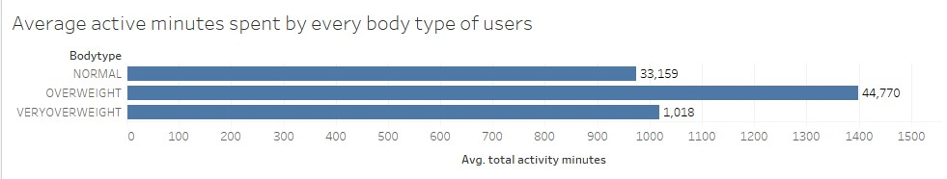
Findings
The figure shows that overweight users spend more active minutes than other users.

Slide 13
Recommendations
From the previous plots we found 3 relationships between user activity and the calories, sleeping time and steps made during the day.
As these analysis are the results of the users data who will use the track devices I recommend that:
Bellabeat can add a function to the smart device that alerts users who tend to be negatively active during the day (with low active minutes).
Bellabeat also can provide healthy tips (remaining count of steps) in order to help users reaching their health goal (calories burnt count).
Bellabeat can ask users to enter their BMI score and determine every user’s body type then they can focus on less active users (Very Overweight users).

Slide 14
Questions?

Slide 15
Thank you

